Slide 1
But Why Is Photography Important, Anyway?
15 Images that Changed or Significantly Impacted the World

Slide 2
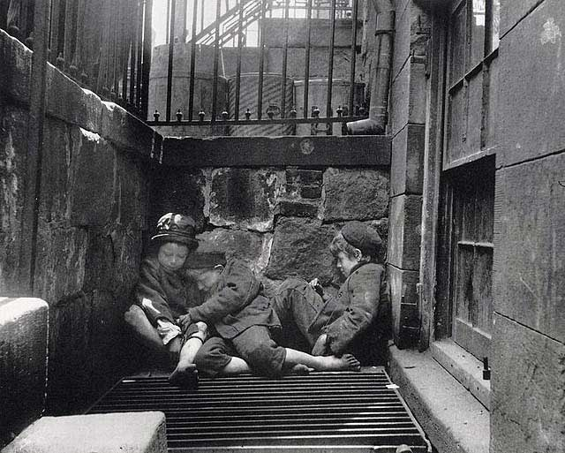
New York City, 1880
Notes:
Jacob Riis chronicled and catalogued the lives of “street arabs” – nomadic children in NYC who had been abandoned or neglected in ways that people are ashamed to treat dogs today. His collection of photos entitled “How the Other Half Lives” eventually led to welfare reform and a re-evaluation of the adoption system.

Slide 3
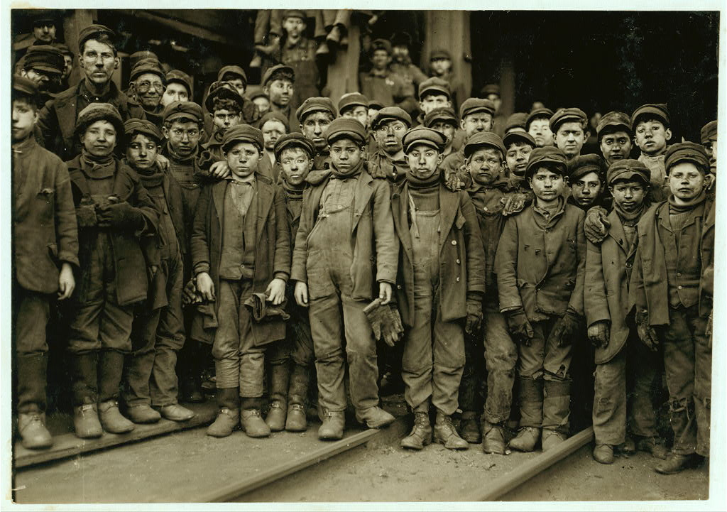
Pennsylvania, 1910
Notes:
Lewis Hine did with photographs what Charles Dickens did with words for impoverished children. Child labor was such a problem at the turn of the century that the federal government actually hired Hine (a Wisconsin native) to take pictures to convince people to put the nation’s 2 million child workers back to school instead of in sweatshops. His series on the “Breaker Boys” did what statistics and words could not – compelled the country to enact laws banning child labor.

Slide 4
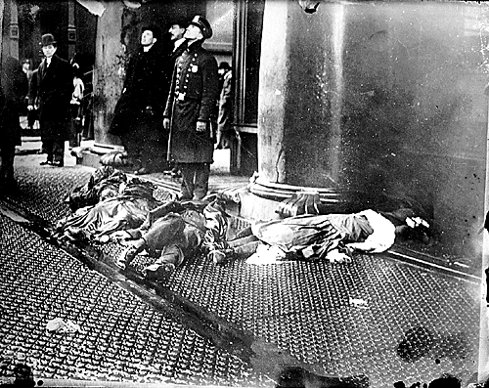
New York City, 1911
Notes:
The Triangle Shirtwaist Fire should never have happened – but mostly immigrant, female workers were forced to work in horrid conditions. They were not allowed to take bathroom breaks, there were no alarms for fires, and a fire escape that was in pieces long before the fire began. Worse, the managers locked the exits to prevent workers from taking unscheduled breaks. This trapped 146 workers in the blaze, who died from burns, aspxhyation, or from jumping off the 8th and 9th floors of the building (as pictured). Originally, those standing by thought the workers were simply tossing down some of the finer cloths to protect them from the flames – until someone checked and realized there were bodies wrapped inside them. The images and story were so horrific, a national crusade for workplace safety was spurred.

Slide 5
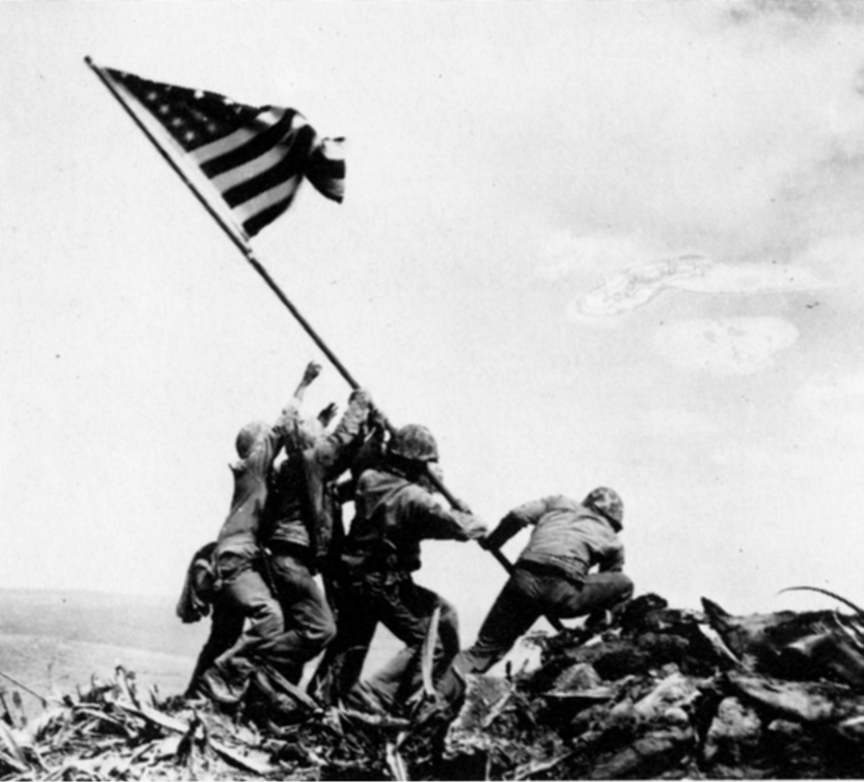
Iwo Jima, 1945
Notes:
US Marines raised the American flag atop Mt. Suribachi on February 23rd, 1945, and Joe Rosenthal was there to snap one of the most iconic images in history. Note that it’s been proved beyond the shadow of a doubt that this image was not staged, planned or altered in any way. The photo showed emphatically just who was on the ascent in the Pacific and had a pure, inspirational quality. In the states, work began instantly on a statue based on this image, and you can visit the Iwo Jima memorial today to see it.

Slide 6
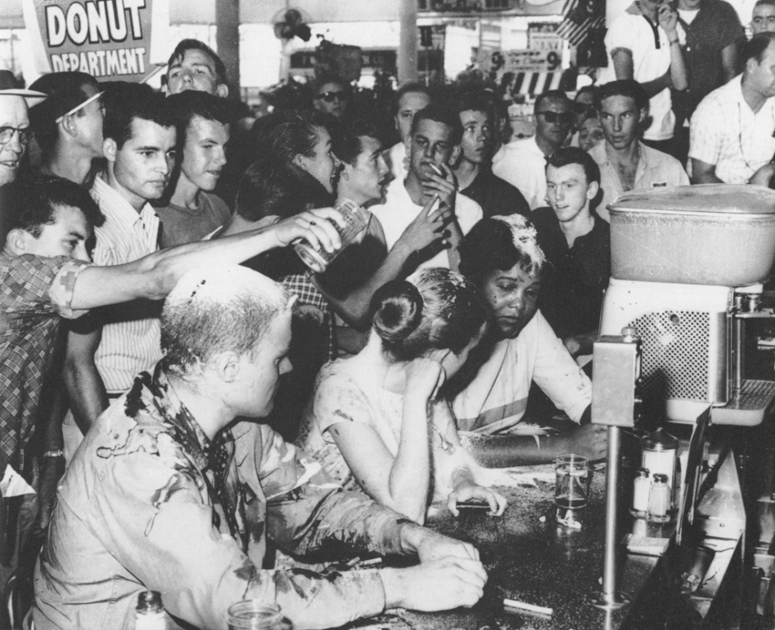
Jackson (Mississippi) 1963
Notes:
Segregation was alive and well in the deep south, where Blacks were not allowed to sit at the same table as whites (or use the same bathroom, water fountain, etc.) To protest this, Dr. Martin Luther King Jr. advocated a peaceful form of protesting called a “sit-in” where Blacks would sit at the tables designated for Whites and calmly request the same service. You can see the results. Even the white gentleman who joined the protest to sit with the blacks is treated like a 2nd class citizen. Images like these slowly began to change public perception on race.

Slide 7
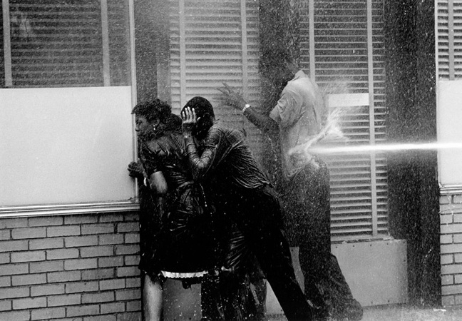
Birmingham (Alabama), 1963
Notes:
Unfortunately, that change didn’t come soon enough. As African-Americans continued to peacefully protest segregation and discrimination, corrupt governmnets and police forces continued to try to keep these “lawbreakers” under control. And by under control, I really mean eliminated. Here, you can see a fire hose being used on three people peacefully marching in Birmingham. Keep in mind that a fire hose operates at a force of 400 pounds per square inch. Because these hoses were often turned on people at point-blank range, more than a couple protesters straight-up died from being hosed; many more were seriously injured.

Slide 8
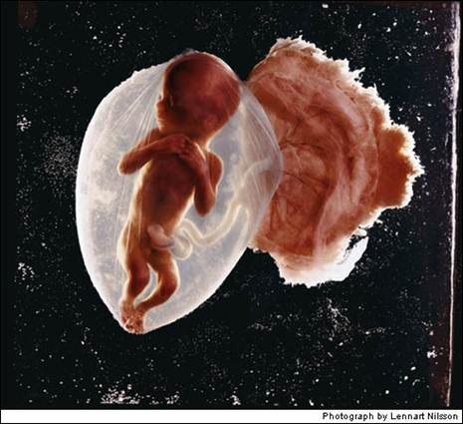
“How Life Begins” 1965
Notes:
In 1957 Lennart Nilsson began taking pictures with an endoscope, an instrument that can see inside body cavities, but it wasn’t until 1965 that he actually got a magazine to believe that what he was doing was actually real and possible. As soon as the photos were released in a 16-page spread in Life, they created a national sensation. Although not intended by the photographer, the images instantly became an iconic rallying cry for the Pro-Life movement.

Slide 9
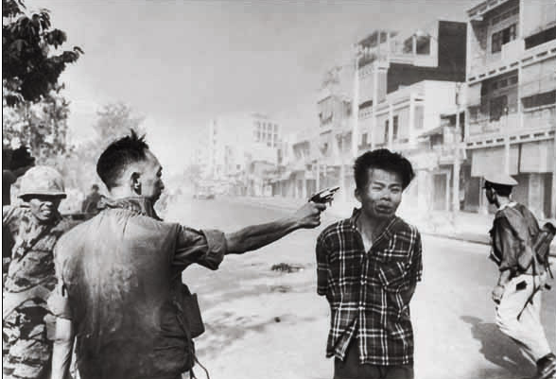
Vietnam, 1968
Notes:
Eddie Adams won a Pulitzer for this image which he later said he regretted taking. Photographing this execution began to turn public favor away from supporting the Vietnam war, as it sparked major outcries of brutality and a lack of justice. But the criminal being executed had killed American soldiers and was accused of committing even more heinous crimes. The shot was almost an accident – Adams whipped his camera up and had no time to adjust his settings or even know if he had successfully captured the scene. Adams later said: “Two people died in that photograph: the recipient of the bullet and GENERAL NGUYEN NGOC LOAN. The general killed the Viet Cong; I killed the general with my camera. Still photographs are the most powerful weapons in the world. People believe them; but photographs do lie, even without manipulation. They are only half-truths.”

Slide 10
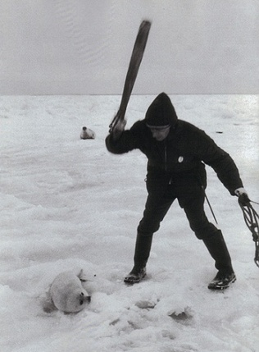
Canada, 1969
Notes:
The annual spring seal hunting season in far northern Canada was shown to the wider world beginning in the mid 60s. Images such as this one, which shows a mother seal in the background watching her children being clubbed to death, ran everywhere and caused a collective outrage. Many consumers stopped buying fur, and many countries banned seal fur imports from Canada.

Slide 11
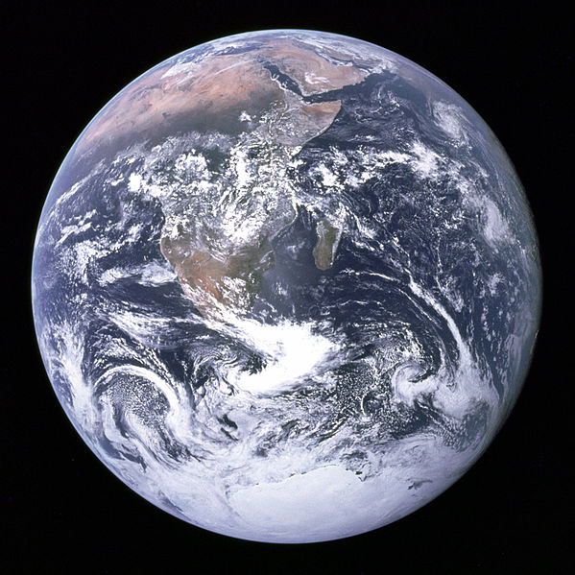
Space, 1972
Notes:
The crew of Apollo 17 was able to take this fully-illuminated snapshot of our world only because the astronauts had the sun behind them as they took the shot. Because this mission was the last manned lunar mission, no one has been far enough away from Earth to take a picture like this one (although many satellites have duplicated the feat). It was immediately jumped on by environmentalists as demonstrating the Earth’s frailty and vulnerability in the vast black emptiness of space.

Slide 12
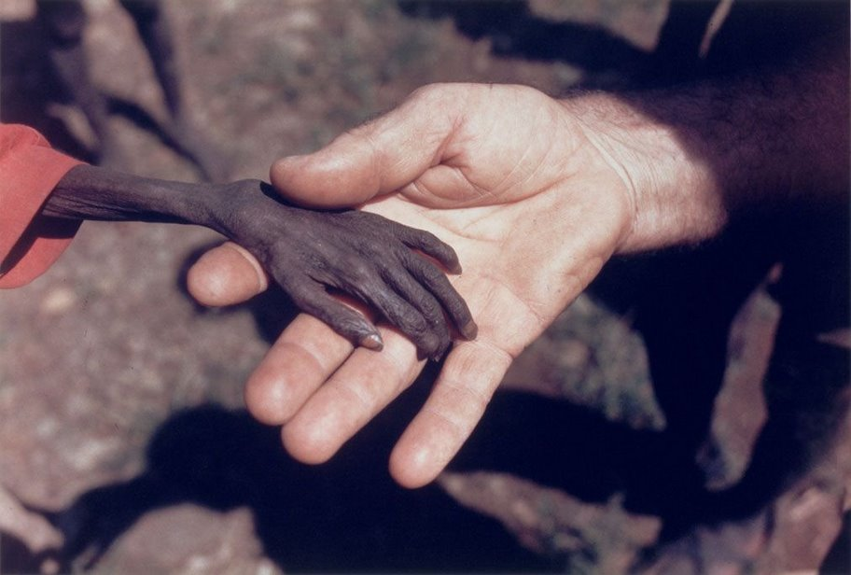
Uganda, 1980
Notes:
Nearly the entire horn of Africa was parched by drought in 1980. In Uganda alone, half a million people were affected, including most newborns and young children. Those who survived barely looked human, with withered and discolored skin. They faced a life of developmental problems. Pictures like this one (of a priest holding the hand of a starving child) moved the United Nations and private groups to send food and clean water to the suffering Africans.

Slide 13
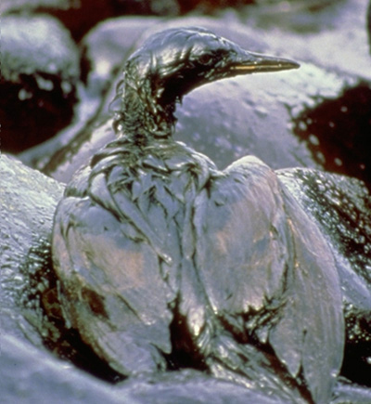
Alaska, 1989
Notes:
On March 24th, 1989, the Exxon-Valdez oil tanker ran aground in Alaska’s Prince William Sound, and 10.8 million gallons of crude oil flowed into the bay, causing what at the time was the worst maritime environmental disaster in US history (the BP oil spill later became the worst, which spilled almost 20 times the amount lost by the Exxon-Valdez). A quarter million seabirds, 2,800 sea otters, 250 bald eagles, and more than 20 killer whales died, and 1,300 miles of shoreline were fouled. The public outcry led to a US law demanding double hull construction in future tankers, and Exxon was ordered by a judge to pay billions in reparations, a decision the company continues to fight to this day.

Slide 14
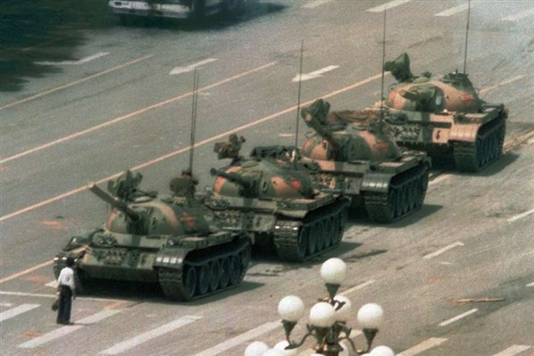
Tiananmen Square (China), 1989
Notes:
A hunger strike by 3,000 students in Beijing had grown to a protest of over 1,000,000 as those affected by the injustices of a nation cried for reform. For seven weeks the people and the Communist Party warily eyed each other as the world watched and waited. When this young man, standing with his meager bags before a line of tanks, refused to move, two heroes were born – the student, and the tank driver who refused to crush the protester as ordered and instead drove around him. This picture showed over a billion Chinese that there is hope.

Slide 15
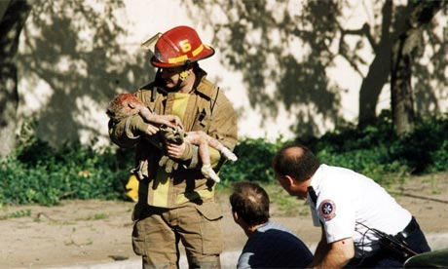
Oklahoma City, 1995
Notes:
One of the blackest moments in American history came when a terrorist bomb destroyed a Federal building in Oklahoma City, Oklahoma (which also contained a day-care center). Of the 168 people killed, 19 were children. That the innocent were slain by their own countrymen made it all the more unbearable. The child held in this picture by firefighter Chris Fields celebrated her birthday only the day before. This Pulitzer-Prize winning photograph was not taken by a professional – it was taken by Charles Porter, a freelance photographer.

Slide 16
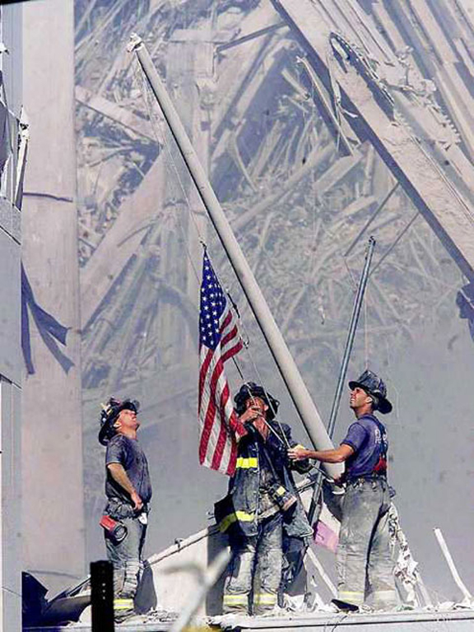
World Trade Center (NYC), 2001
Notes:
There are memorable images of Old Glory from the Revolutionary War, the Civil War, WWI and WWII. Yet on September 11th, 2001, we found ourselves in yet another war – this time with Terrorism. Much of the attack is familiar because of oft-seen TV footage, but this image has come to represent our ensuing pride of the place and event. However, the flag pictured would eventually become lost after several planned trips, and to this day no one knows where it ended up.

